Slide 1
Wordcount + PageRank + Apache Spark + GKE
Arsiema Yohannes
20039

Slide 2
Table of Content
Introduction
Design
Implementation
Test
Enhancement ideas
Conclusion

Slide 3

Introduction
Platform for this project is Google Cloud Platform
Technology used
Google Kubernetes Engine (GKE)
PySpark
Functions
Word Count
Page Rank

Slide 4
Design
PySpark is a combination of Apache Spark and Python
Apache Spark
Fast, in-memory data processing engine which allows data workers to efficiently execute streaming, machine learning or SQL workloads that require fast iterative access to datas
Advantages of Spark
Run computations in memory
100x faster in memory and 10x faster even when running on disk than MapReduce
Easy to combine different processing models seamlessly in the same application.
Python is a general purpose, high level programming language. It is commonly used for machine learning and real-time streaming analytics

Slide 5
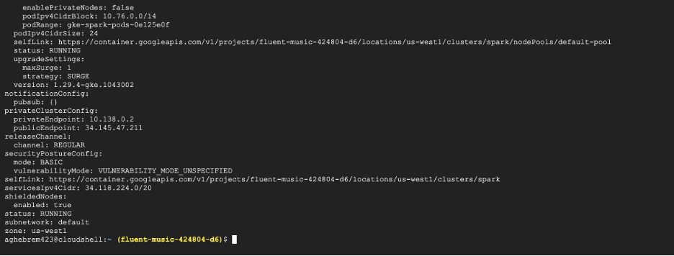
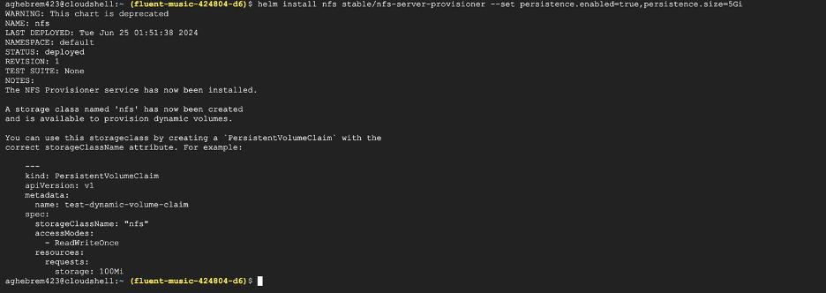
Implementation
Create cluster on GKE
Install the NFS Server Provisioner

Slide 6
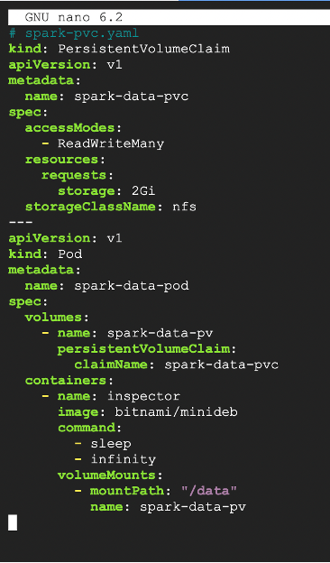
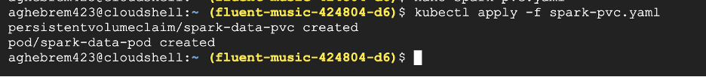
Implementation
3. Create a persistent disk volume and a pod to use
NFS spark-pvc.yaml.
4. Apply the above yaml descriptor

Slide 7
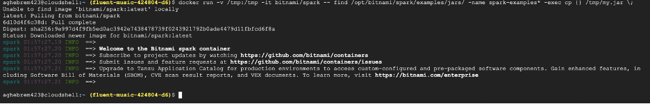
Implementation
5. Create and prepare your application JAR file.
6. Add a test file with a line of words that we will be using later for the word count test.

Slide 8
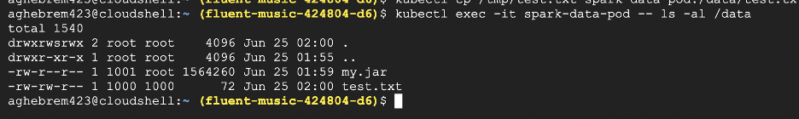
Implementation
7. Copy the JAR file containing the application, and any other required files, to the PVC using the mount point.
8. Make sure the files a inside the persistent volume

Slide 9
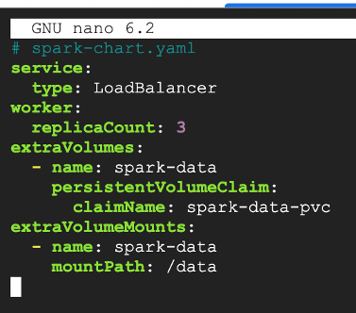
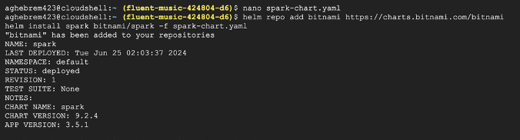
Implementation
9. Deploy Apache Spark on Kubernetes using
the shared volume spark-chart.yaml.
10. Deploy Apache Spark on the Kubernetes cluster using the Bitnami Apache Spark Helm chart and supply it with the configuration file above.

Slide 10
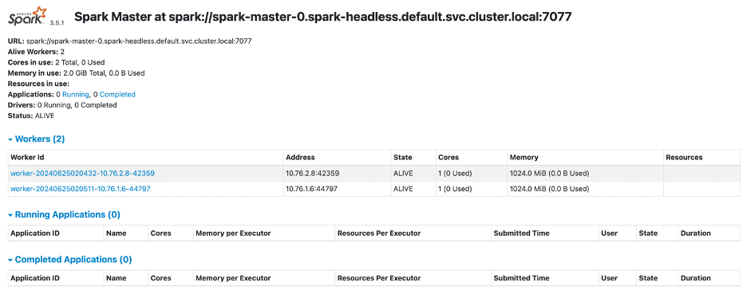
Implementation
11. Get the external IP of the running pod.
12. Open the external ip on your browser,

Slide 11
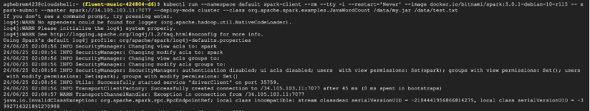
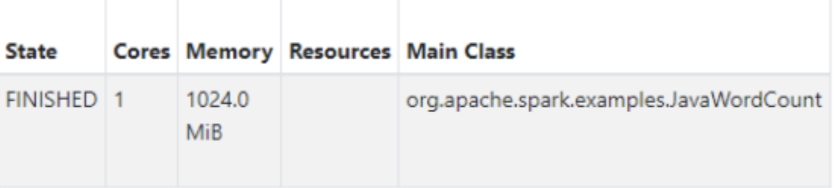
Test
13. Run Word Count on Spark
14. Refresh the browser to see the completed task: On the browser, you should see the worker node ip address of the finished task.

Slide 12
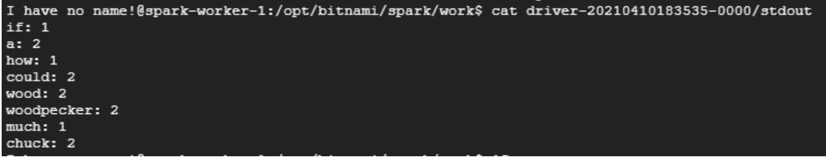
Test
15. Execute the pod to see the result of the task.
16. Execute the spark master pod (You will need to do a portion of the Word Count tutorial to generate this pod).

Slide 13
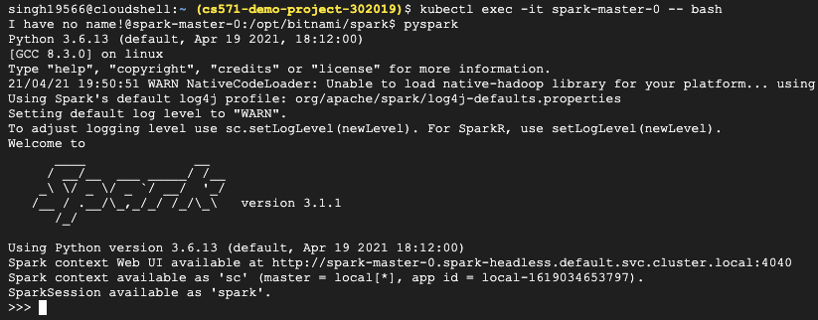
Test
17. Start Pyspark
18. Exit Pyspark.

Slide 14
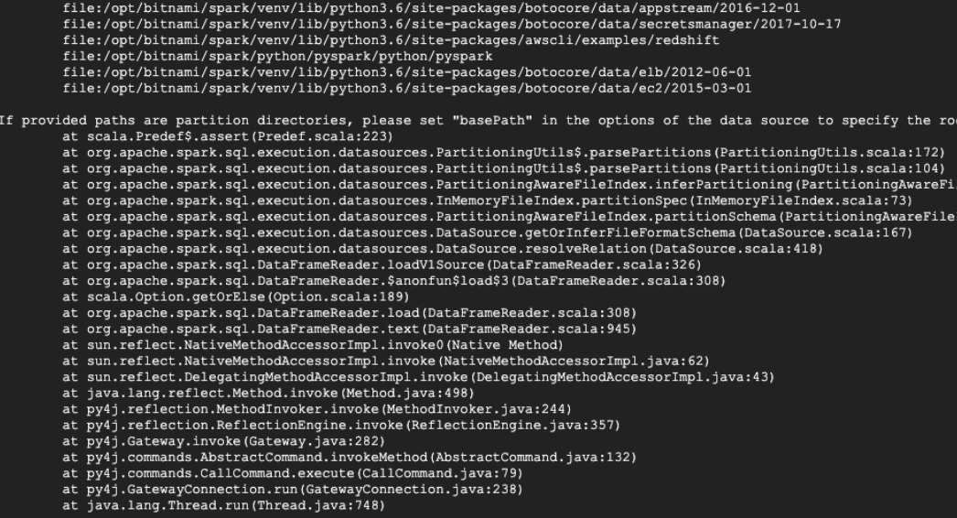
Test
19. Go to the directory where pagerank.py located
Run the page rank using pyspark

Slide 15
Enhancement ideas
Implement Machine Learning Features
Use Apache Spark's MLlib to provide predictive analytics.
Enhance user experience with personalized recommendations based on usage patterns.
Enable real-time learning from user interactions to improve system performance.

Slide 16
Conclusion
In conclusion, the project effectively harnesses Apache Spark's powerful data processing capabilities to facilitate efficient handling of real-time data and complex analytics. By leveraging technologies like Helm for deployment and Kubernetes for orchestration, the solution ensures scalability and reliability. This approach not only streamlines operations but also enhances user experience, positioning the project for future growth and adaptability in a rapidly evolving technological landscape.

